Slide 1

Introduction to NLP
Video 1: What is NLP ?

Slide 2
In Air

Slide 3




Introduction
ARTIFICIAL INTELLIGENCE
Linguistics
MACHINE LEARNING
Computer Science
DEEP LEARNING
CV NLP
Artificial intelligence

Slide 4

Introduction
ARTIFICIAL INTELLIGENCE
MACHINE LEARNING
NLP enables computers to understand, interpret and respond to human languages or text data.
DEEP LEARNING
CV NLP

Slide 5
Categories of NLP
Deep Learning Applications
Natural Language Understanding (NLU)
Natural Language Generation (NLG)

Slide 6



1. Natural Language Understanding (NLU)
Ability of a machine to understand and interpret human language the way it is spoken or written.
For example :
River bank
Bank

Slide 7

1. Natural Language Generation (NLG)
Ability of a machine to generate unique human-like text or speech.
For example :
chatbots

Slide 8

Applications of NLP
NLP
Text based generative AI tools
Search Engines
Virtual Assistants
Translation Services
Sentiment Analysis
Email Filters
Content Recommendation
Resume Screening
Content Categorizations

Slide 9

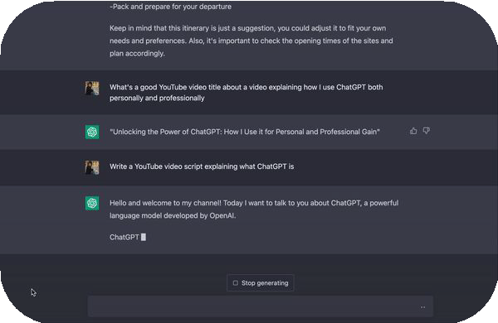

1. Text Based Generative AI tools
NLP
ChatGPT
Google BARD
Text based Gen AI tools
Search Engines
Virtual Assistants
Translation Services
Sentiment Analysis
Email Filters
Content Recommendation
Resume Screening
Content Categorizations

Slide 10


2. Search Engines
NLP
Google Chrome
Yahoo Search
Text based Gen AI tools
Search Engines
Virtual Assistants
Translation Services
Sentiment Analysis
Email Filters
Content Recommendation
Resume Screening
Content Categorizations

Slide 11
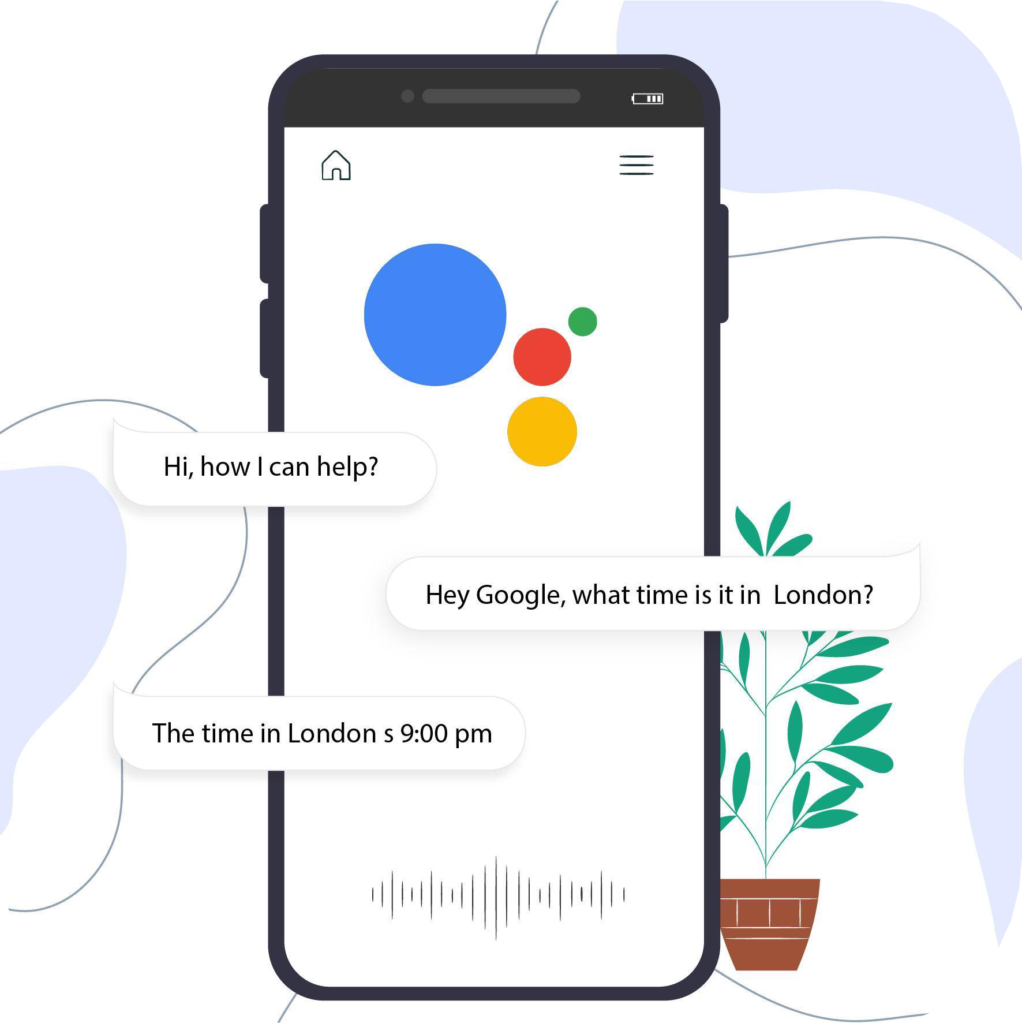

3. Virtual Assistants
NLP
Google Assistants
Virtual Assistants
Text based Gen AI tools
Search Engines
Virtual Assistants
Translation Services
Sentiment Analysis
Email Filters
Content Recommendation
Resume Screening
Content Categorizations

Slide 12
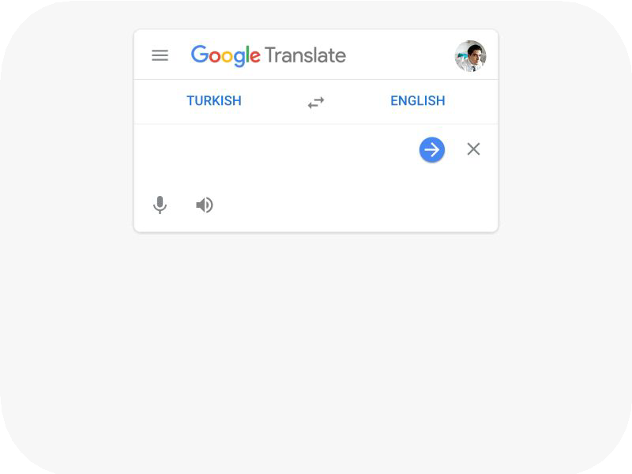

4. Translation Services
NLP
Google Translate
Text to Speech
Text based generative AI tools
Search Engines
Virtual Assistants
Translation Services
Sentiment Analysis
Email Filters
Content Recommendation
Resume Screening
Content Categorizations

Slide 13


5. Sentiment Analysis
NLP
Customer Feedback
Social Media Conversation
Text based generative AI tools
Search Engines
Virtual Assistants
Translation Services
Sentiment Analysis
Email Filters
Content Recommendation
Resume Screening
Content Categorizations

Slide 14
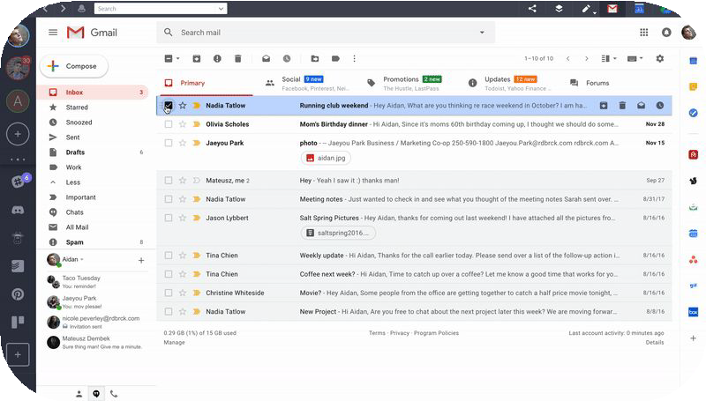
6. Email Filters
NLP
Spam email
Text based generative AI tools
Search Engines
Virtual Assistants
Translation Services
Sentiment Analysis
Email Filters
Content Recommendation
Resume Screening
Content Categorizations

Slide 15
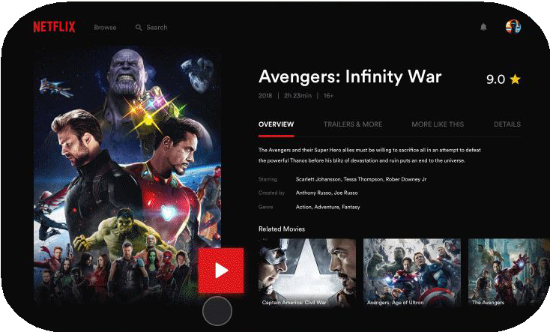

7. Content Recommendation
NLP
Netflix
News Aggregators
Text based generative AI tools
Search Engines
Virtual Assistants
Translation Services
Sentiment Analysis
Email Filters
Content Recommendation
Resume Screening
Content Categorizations

Slide 16

8. Resume Screening
NLP
Resume as per Job requirements
Text based generative AI tools
Search Engines
Virtual Assistants
Translation Services
Sentiment Analysis
Email Filters
Content Recommendation
Resume Screening
Content Categorizations

Slide 17
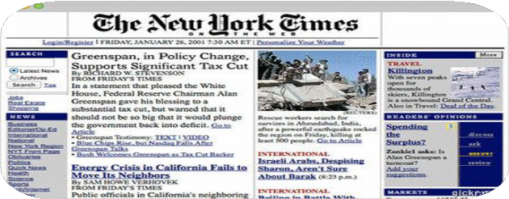
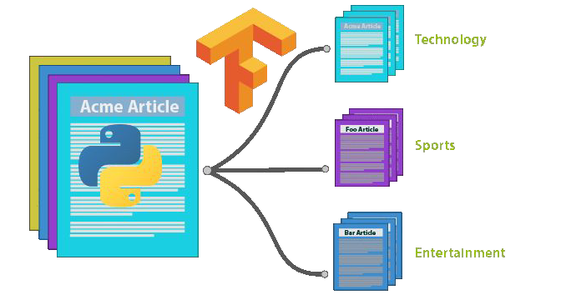
9. Content Categorization
NLP
News Article
Academic papers
Text based generative AI tools
Search Engines
Virtual Assistants
Translation Services
Sentiment Analysis
Email Filters
Content Recommendation
Resume Screening
Content Categorizations

Slide 18

Applications of NLP
NLP
Text based generative AI tools
Search Engines
Virtual Assistants
Translation Services
Sentiment Analysis
Email Filters
Content Recommendation
Resume Screening
Content Categorizations

